Slide 1
Gyürki Zoli
@GreenFox

Slide 2
University years
Education
Human Resources
Notes:
This is what Ive learnt

Slide 3
University years
ELTE
BGE
Notes:
This is where

Slide 4
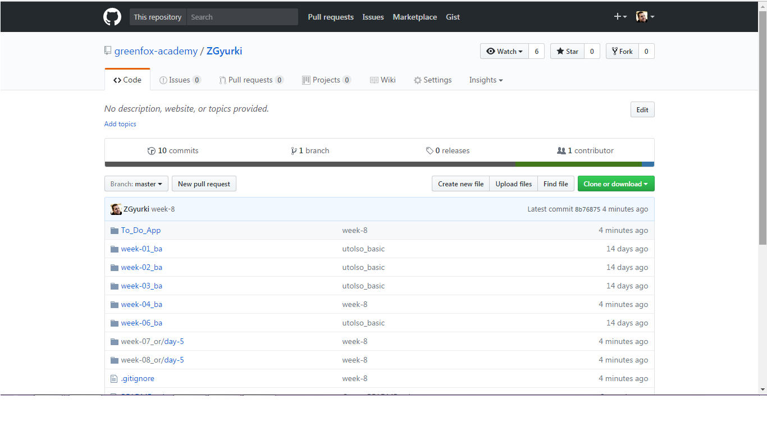
Notes:
..and my INDEX here – my repository

Slide 5
Micro:Bit

Slide 6
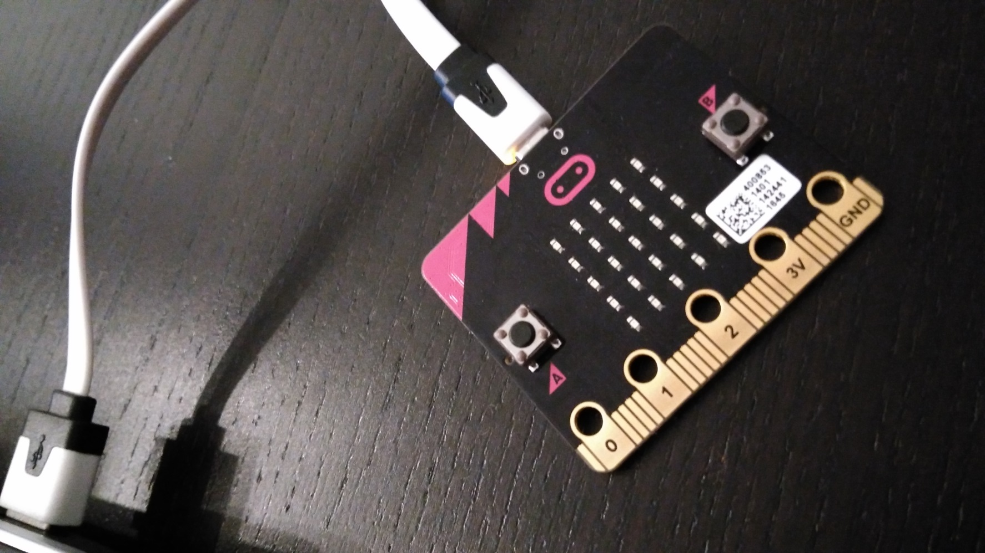
Notes:
The first board Ive met

Slide 7
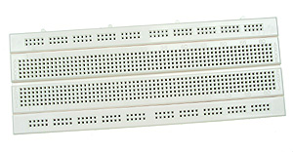
Notes:
The second – breadboard – as U know

Slide 8
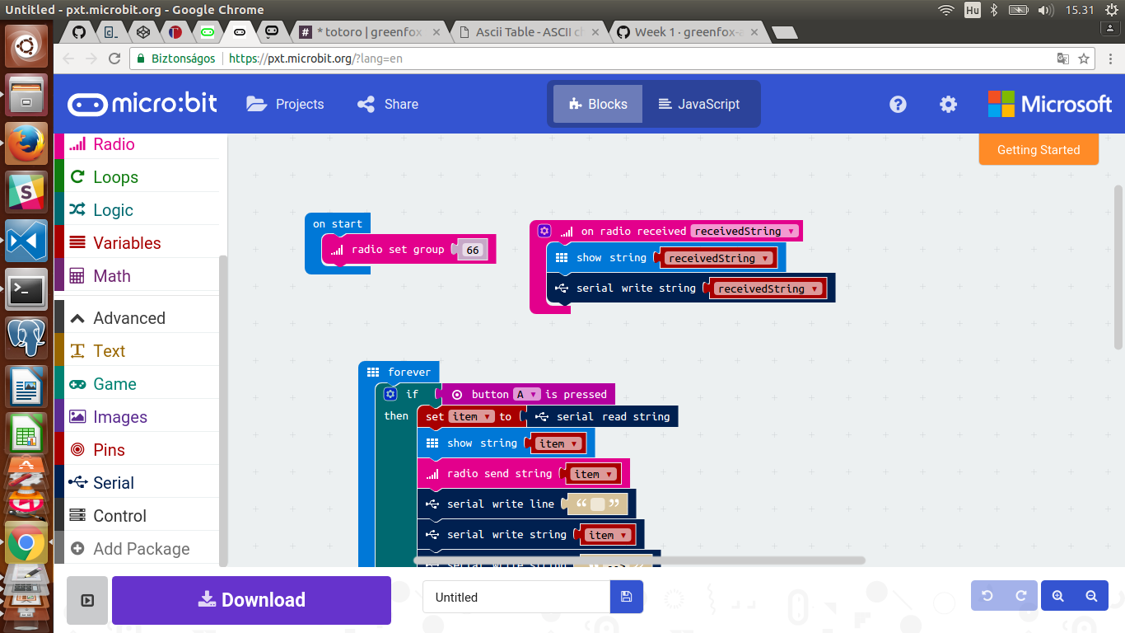
Notes:
One of my codes

Slide 9
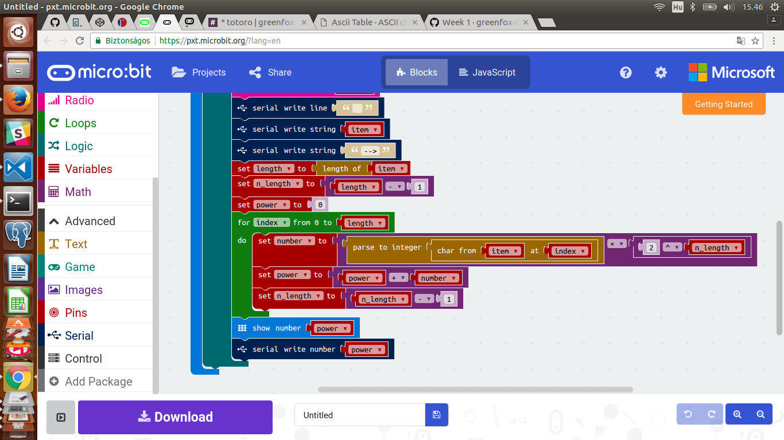

Slide 10
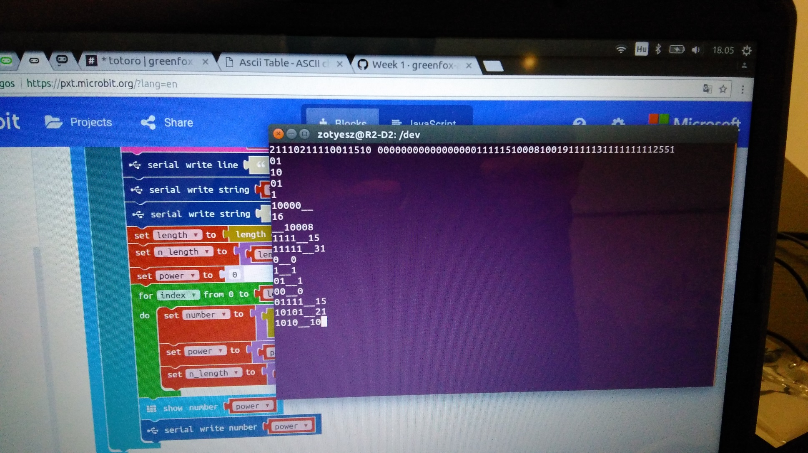
Notes:
Serial Port communication

Slide 11
ATmega 168PB
Notes:
And then we changed → Our second step into this world

Slide 12
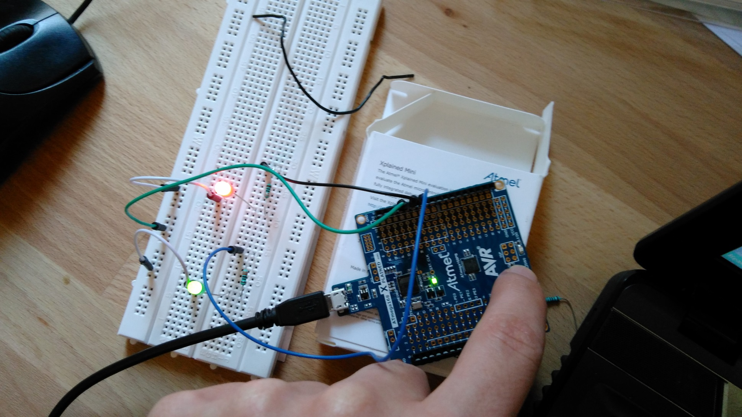
Notes:
I shot some photo and U can see a couple of projects → LED blinking by one touch

Slide 13
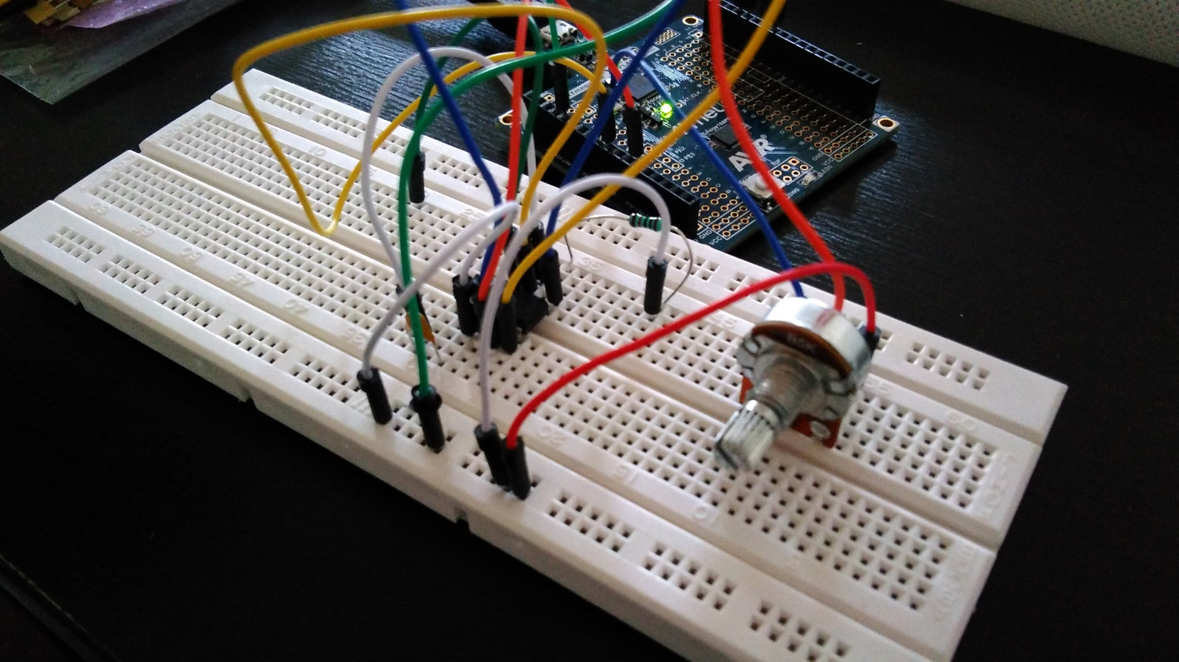
Notes:
Controlling with pot.meter

Slide 14
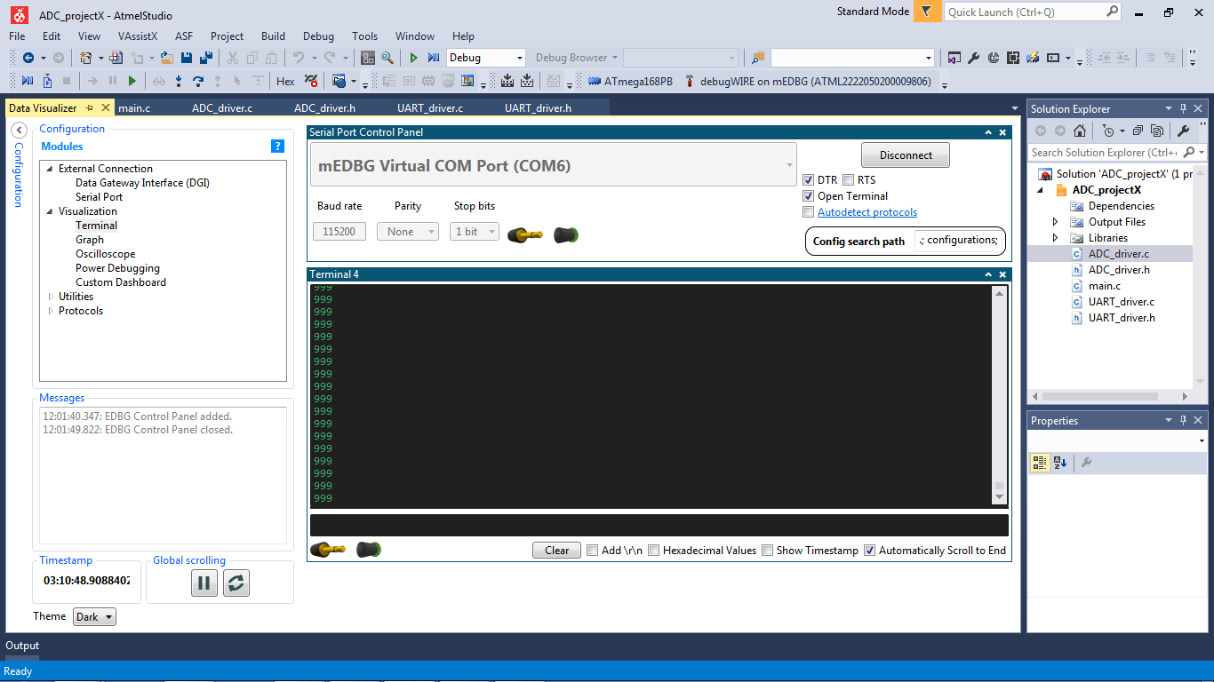
Notes:
..and its result – our ADC project

Slide 15
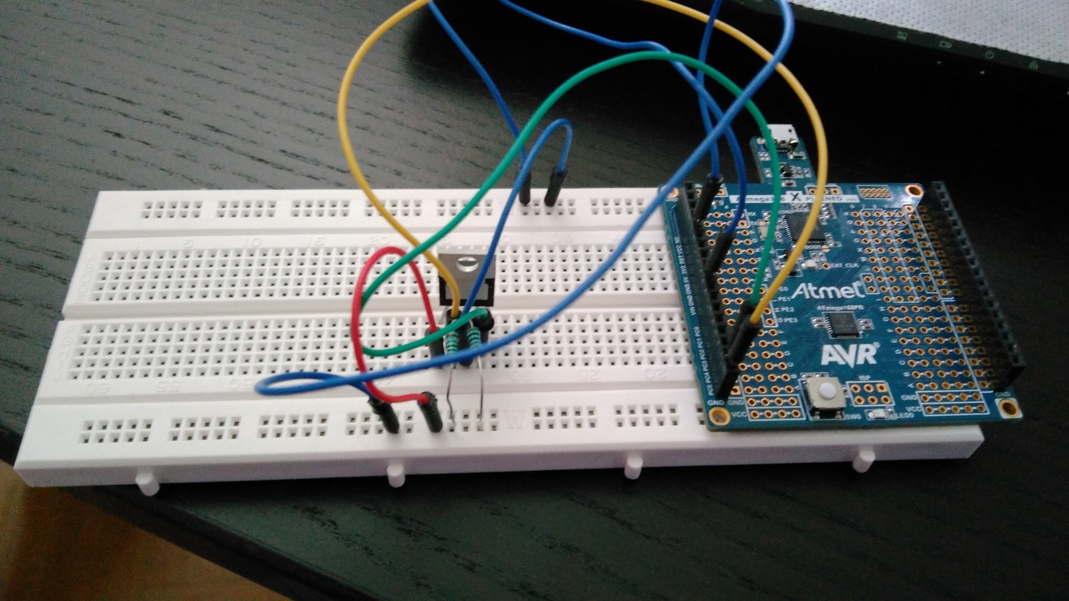
Notes:
Temperature measuring

Slide 16
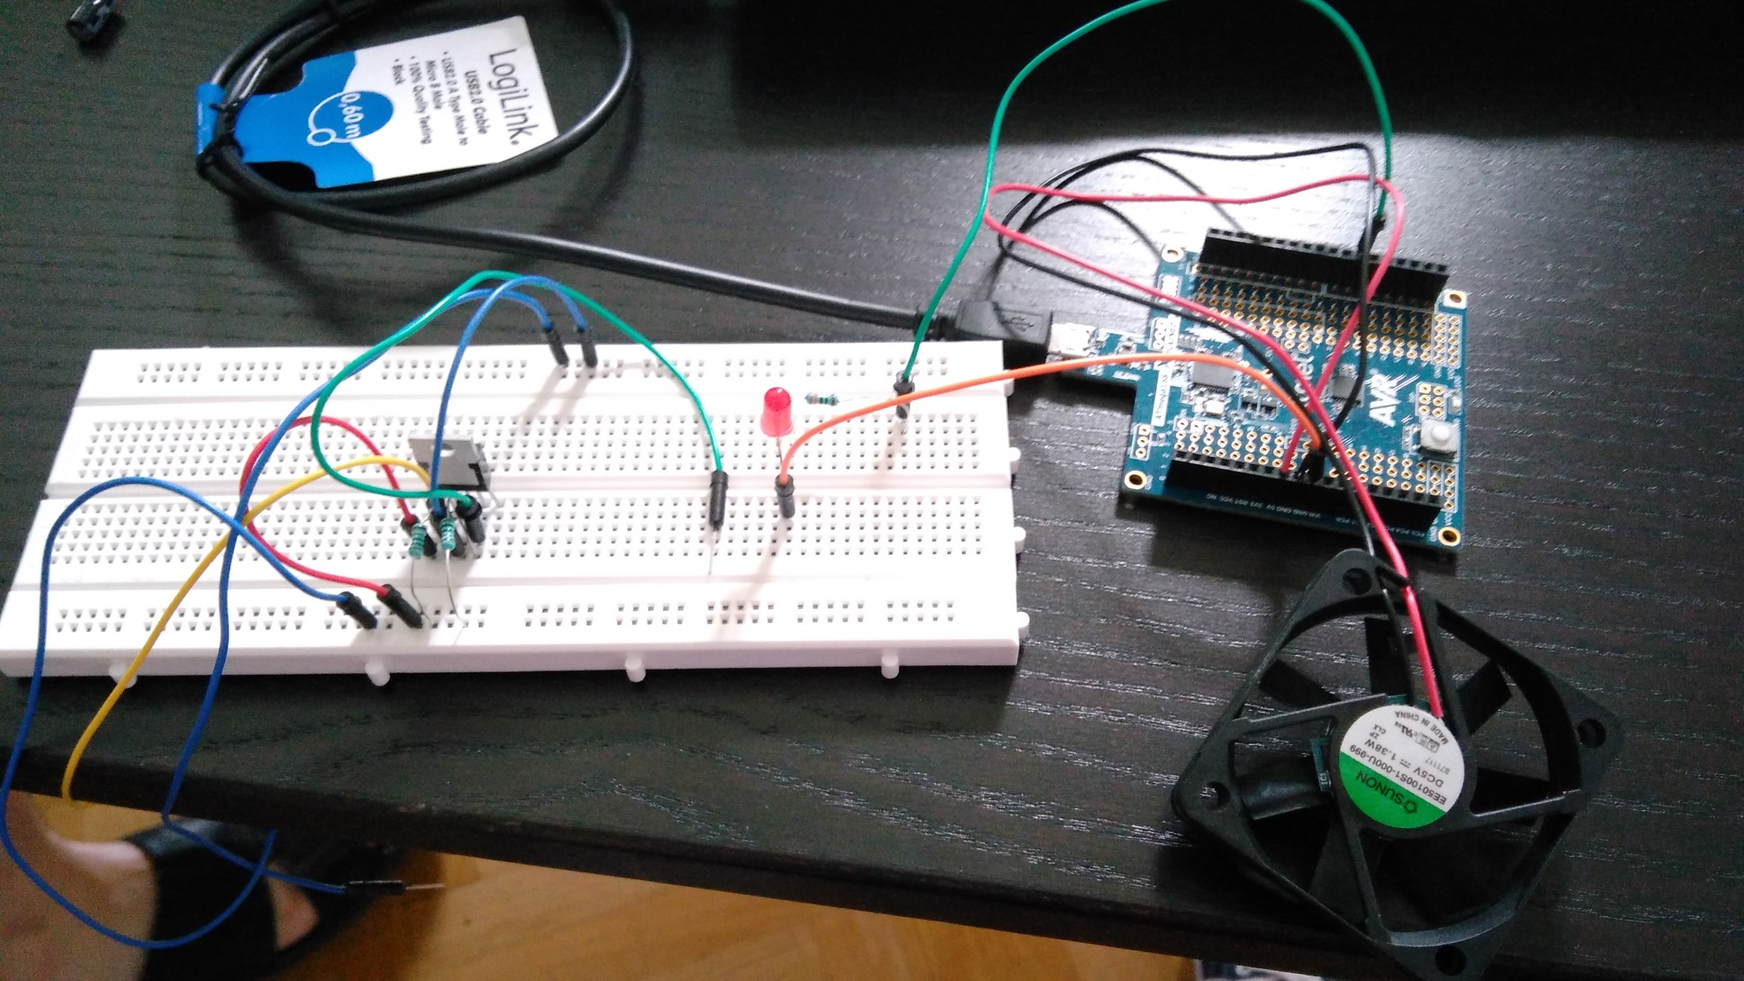
Notes:
It can be complicated with an air-propeller

Slide 17
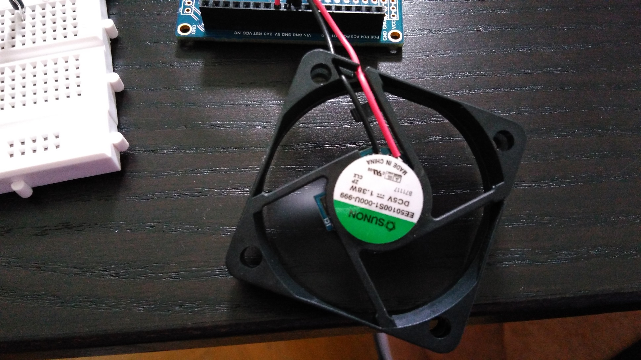
Notes:
..it works

Slide 18
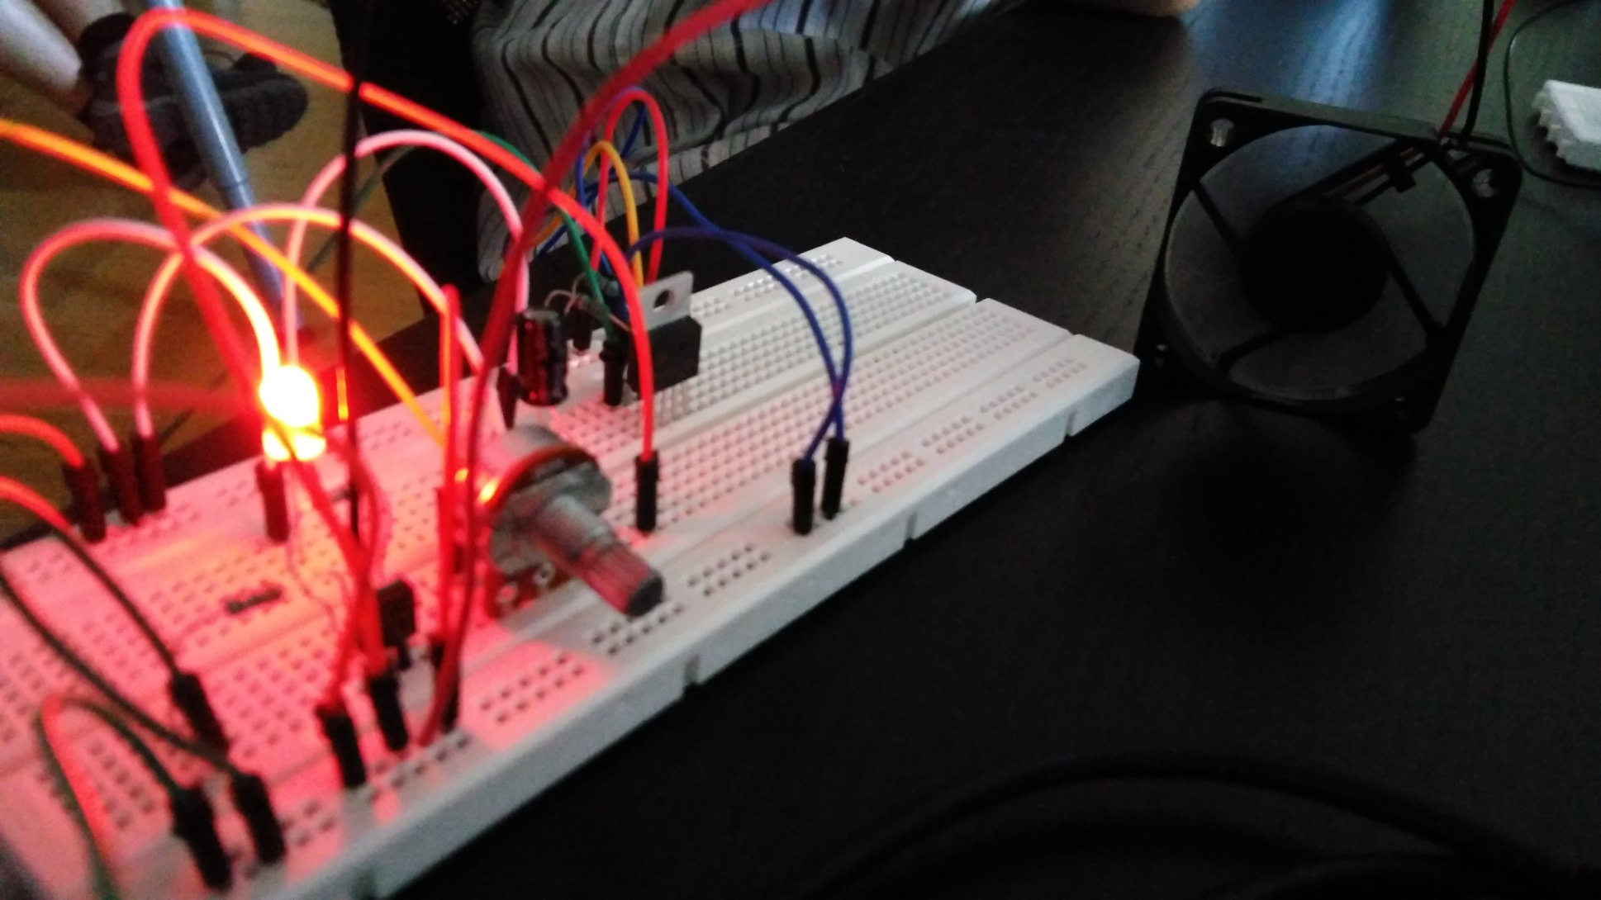
Notes:
Working soo much

Slide 19
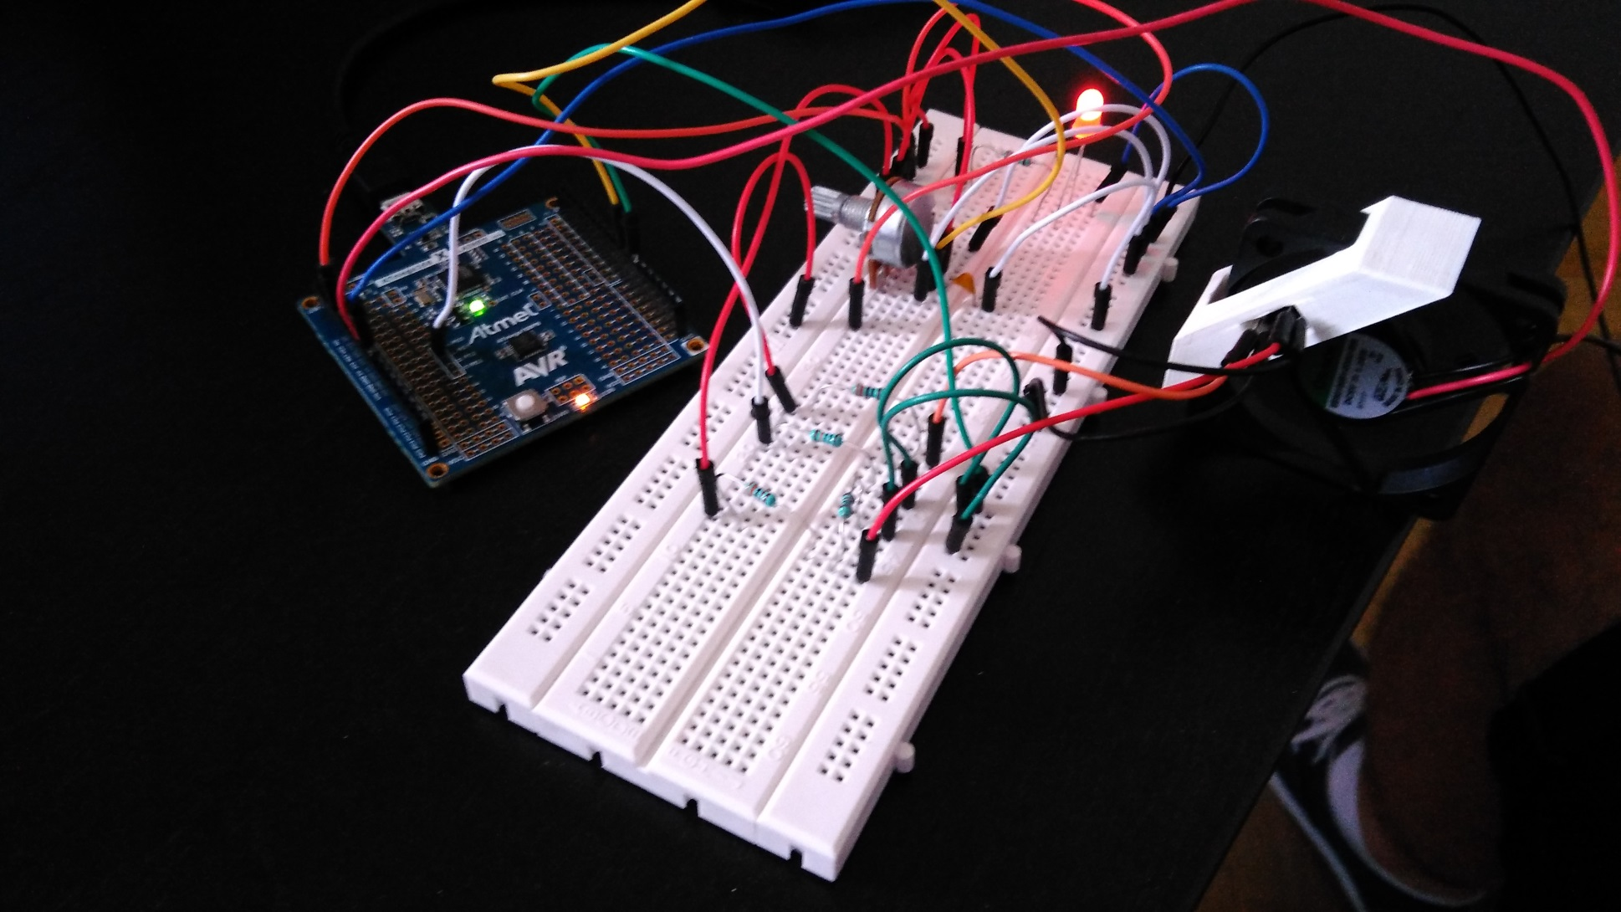
Notes:
Frequency and revolution tests

Slide 20
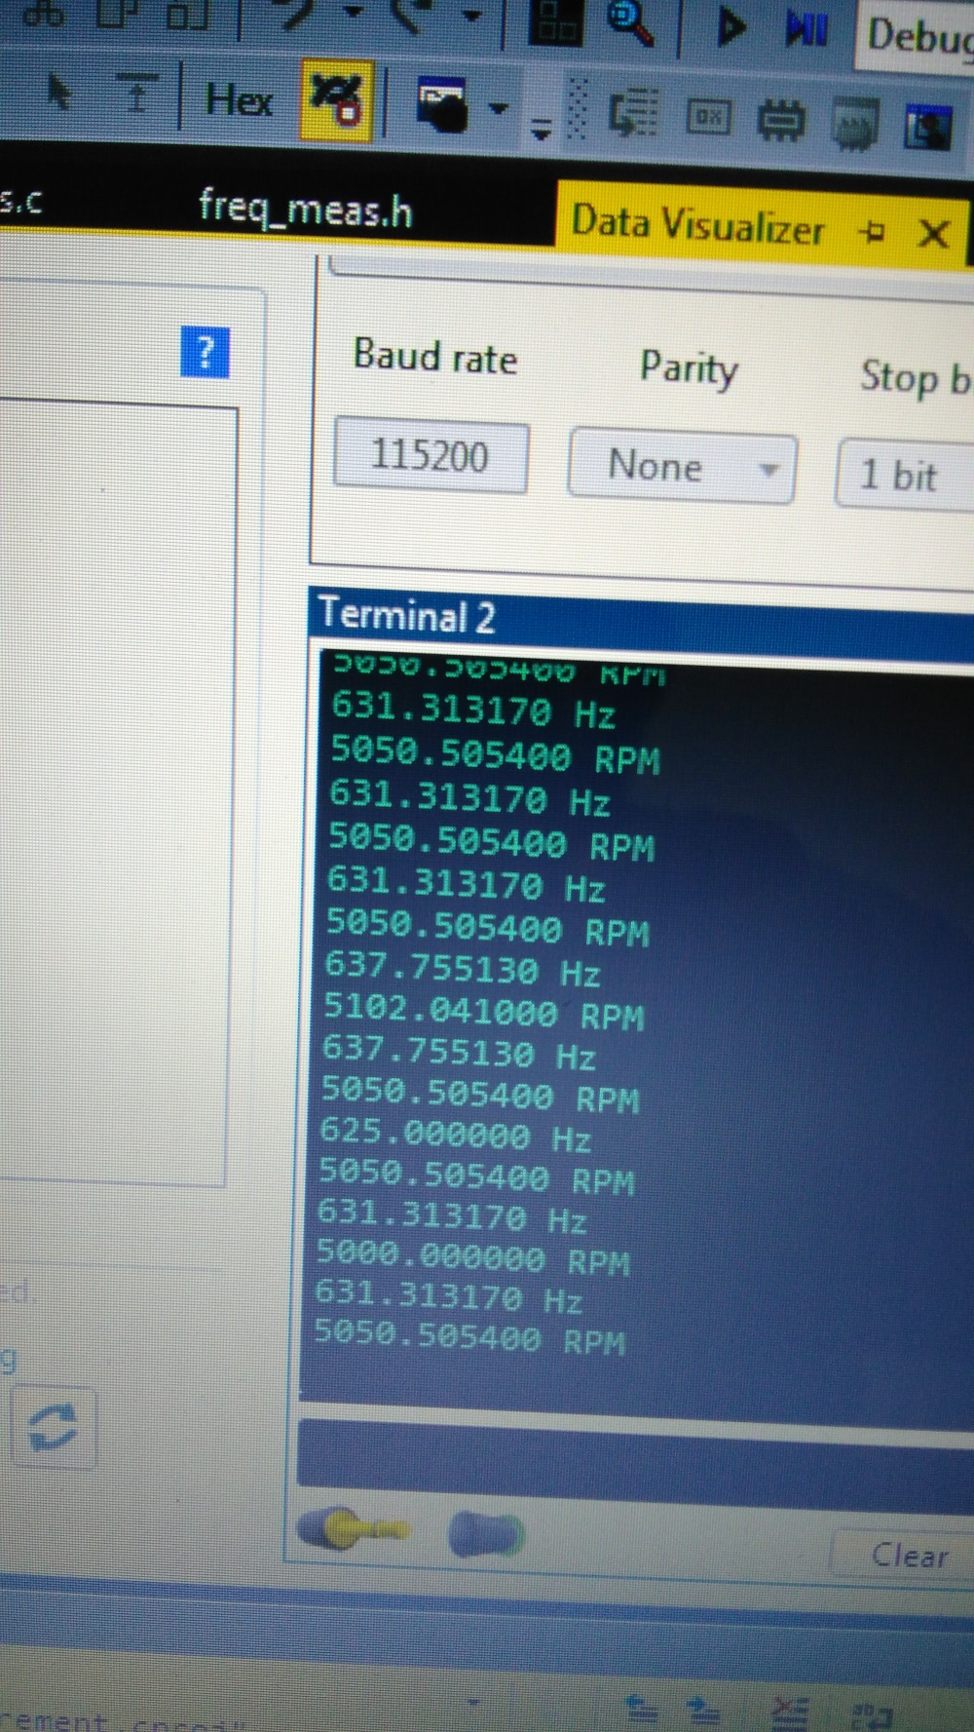
Notes:
..and its datas

Slide 21
Stm32f7 - discovery
Notes:
..and then we changed again

Slide 22
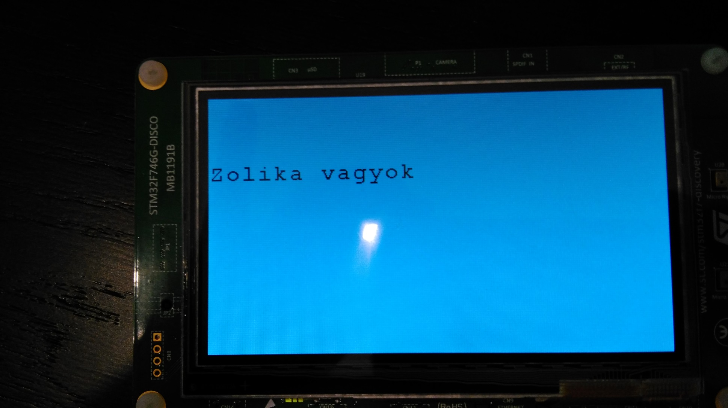
Notes:
Some new FEATURE from this week – and I also have a video where its moving – thats nice, please imagine

Slide 23
C – the language
Notes:
This is the base of our work

Slide 24
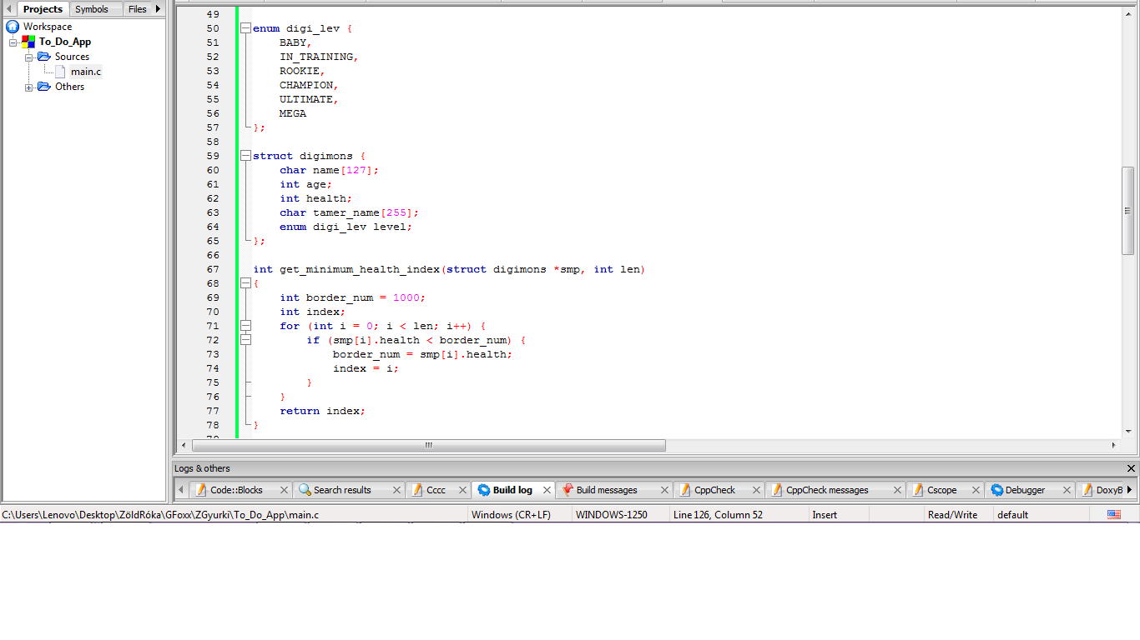
Notes:
Why I love → Digimons – one of our exam excersise

Slide 25
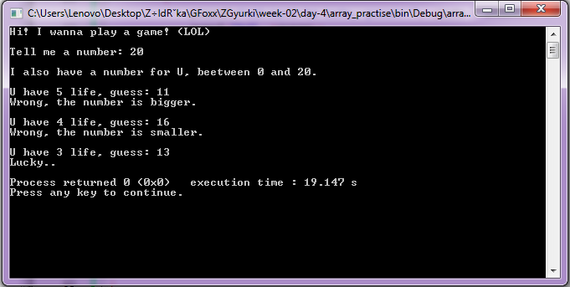
Notes:
..a guessing game → my favourite

Slide 26
Data-structures
Memory-allocation
Notes:
Some sweets → why I hate

Slide 27
summary

Slide 28
better in C
better in problem solving
Notes:
My prides

Slide 29
better in tolerating pain
Notes:
..and yes it hurts

Slide 30
Thanks for your attention!

